Slide 1


AI in the Classroom: Practical Applications and Early Results
Bobby Hodgkinson
Track 1, Wednesday
AI Workshop Denver, CO April 2-3, 2025

Slide 2

Outline
This beginner-friendly talk explores how AI-assisted tools are transforming education, from content creation and delivery to providing timely and effective assessment feedback. Attendees will learn about practical applications of AI in both student-facing and behind-the-scenes educational tasks. The session will also highlight preliminary research results on the efficacy of these tools, offering insights into how AI is being used to enhance education at both higher education and K-12 levels.
Bobby Hodgkinson
Associate Teaching Professor
Smead Aerospace Engineering Sciences
University of Colorado Boulder
Experiential Learning
Gen AI ‘enthusiast’

Slide 3
Assumptions & Outline
Beginner level
Limited technical exposure
‘AI’ means ‘Generative AI’
Audience: Education and Researchers
Future is AI-augmented
Not replace human
More bandwidth for human-human interactions
Familiar with ethical limitations of AI (bias, etc.)
Responsibility of educators to explore use cases
Prepare upcoming generation
Paint a picture of tomorrow’s classroom
Tomorrow may be closer than we may think
Content not sponsored by OpenAI, Google, etc.
Images created with ChatGPT
Student quotes used with permission
Notes:
Mention daughters as a cornerstone of painting the picture

Slide 4

Notes:
Classroom of the future…
So let me paint a picture of education: a personalized learning assistant in the pocket of every student. “A blonde headed female who grew up in Boulder, CO and enjoys skiing and dogs is walking to her next class which is in aerodynamic propulsion and today’s topic is enthalpy and entropy analysis of a jet engine.” She gets a 7 minute personalized steam of short videos relating that topic to her interests whereas her friend who is from the Bayou outside new orleans gets a different podcast but still on the same subject. Same topic different learning styles but now both these students come to class prepared. And at the end of the podcast or video clip, they are presented with the same primer question, which they answer while walking into the lecture hall..and their responses using their own natural laungage are immediately compared to an expert evaluation, and sent to their course instructor so that she can talk about the results to open the course. The instructor doesn’t have to comb through 300 questions in a limited format like multiple choice and hope that the distractors are appropriate to capture the unique understandings of her 300 different student - the AI gleens and categorizes into the top 5 or 10 responses. Then when the student are leaving class they are presented with follow-up content that is unique to them, reinforcing the lecture and priming them for the example problems that are also unique to them given what their future career interests are.
### **II. Vision: Personalized Education**
**Slide 1: Student-Centered Learning**
- Personalized educational content
- Tailored student interest approach
- Different formats, same concept
- AI-driven prep efficiency
**Slide 2: Real-Time Assessment**
- Pre-class primer questions
- Natural language student responses
- Instant instructor insight summary
- Post-class tailored reinforcement

Slide 5

Student facing
Aptos 18 pt black Text Body
Notes:
Let’s focus first on the students as they engage with the material
Slide 1: Student-Facing Examples**
- Custom AI explanations available
- NotebookLM personalized topics
- Reinforce student course engagement
- AI-generated follow-up questions

Slide 6
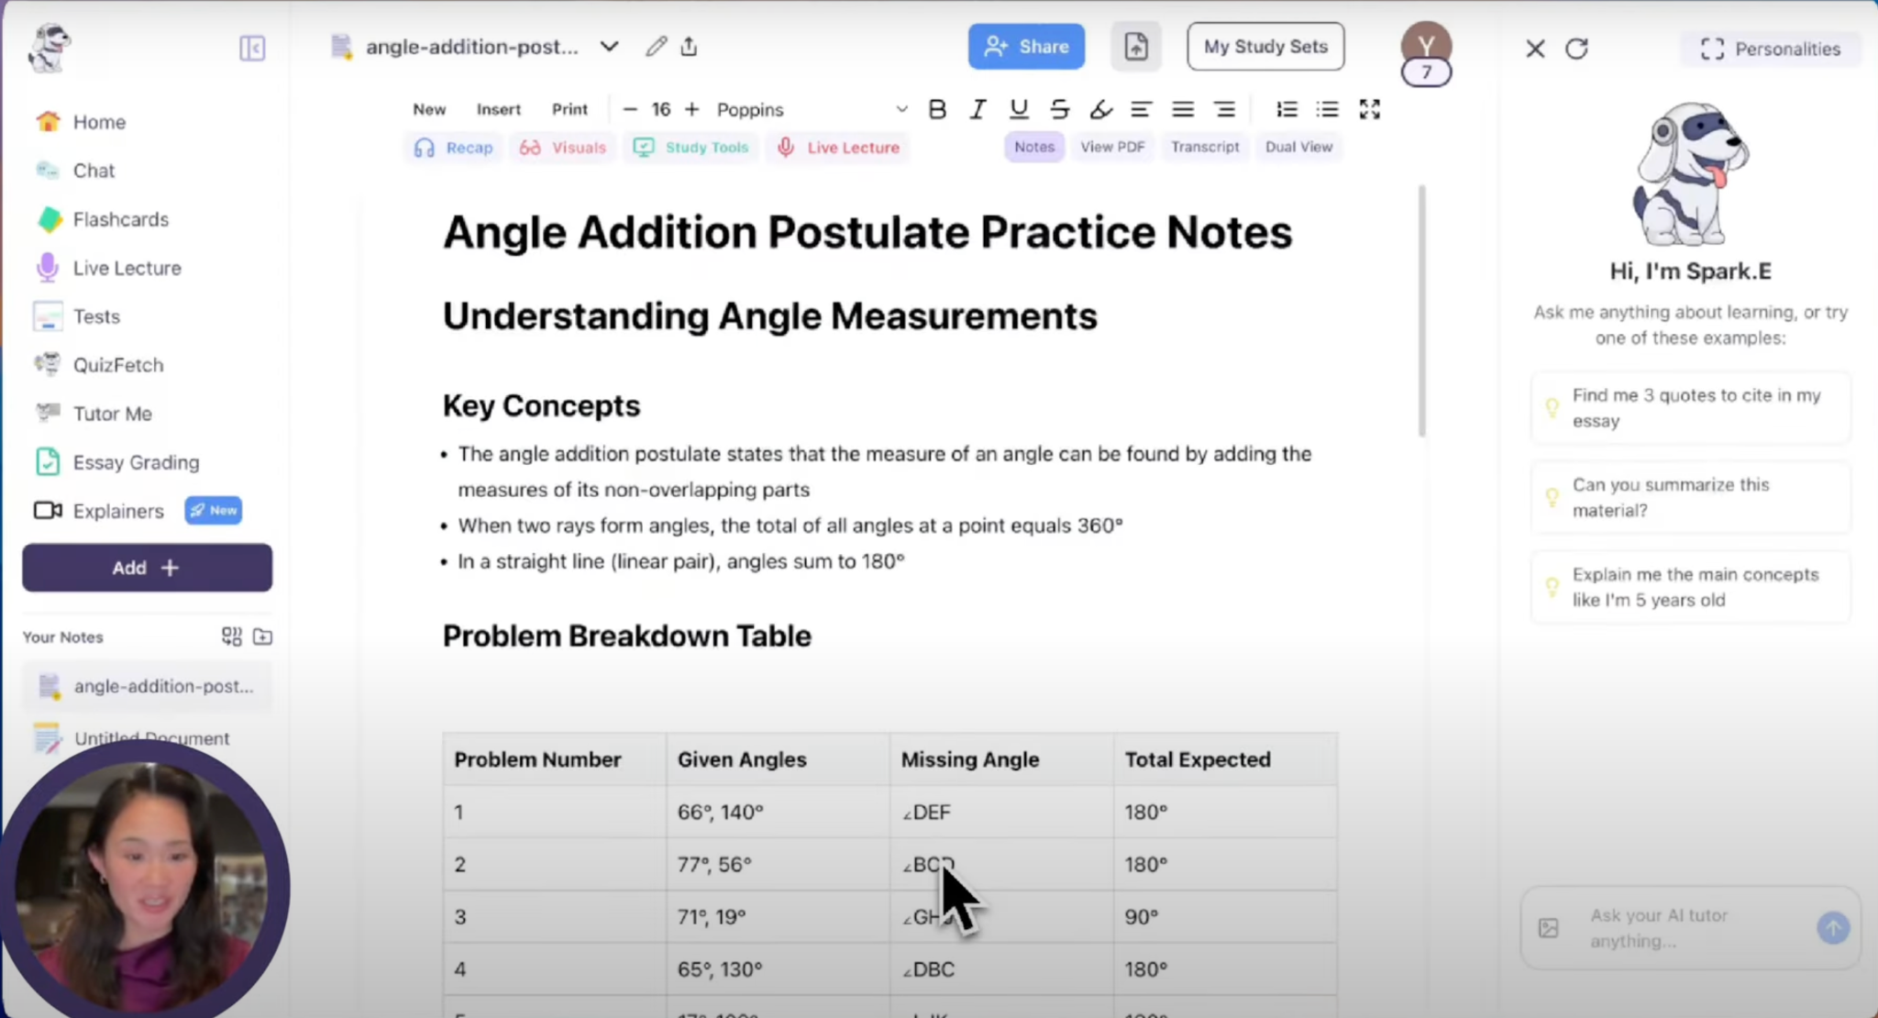
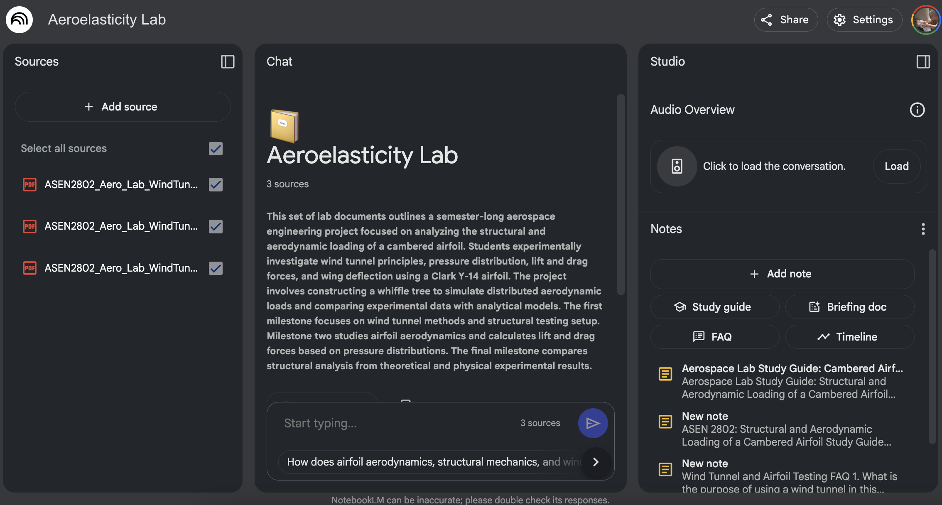
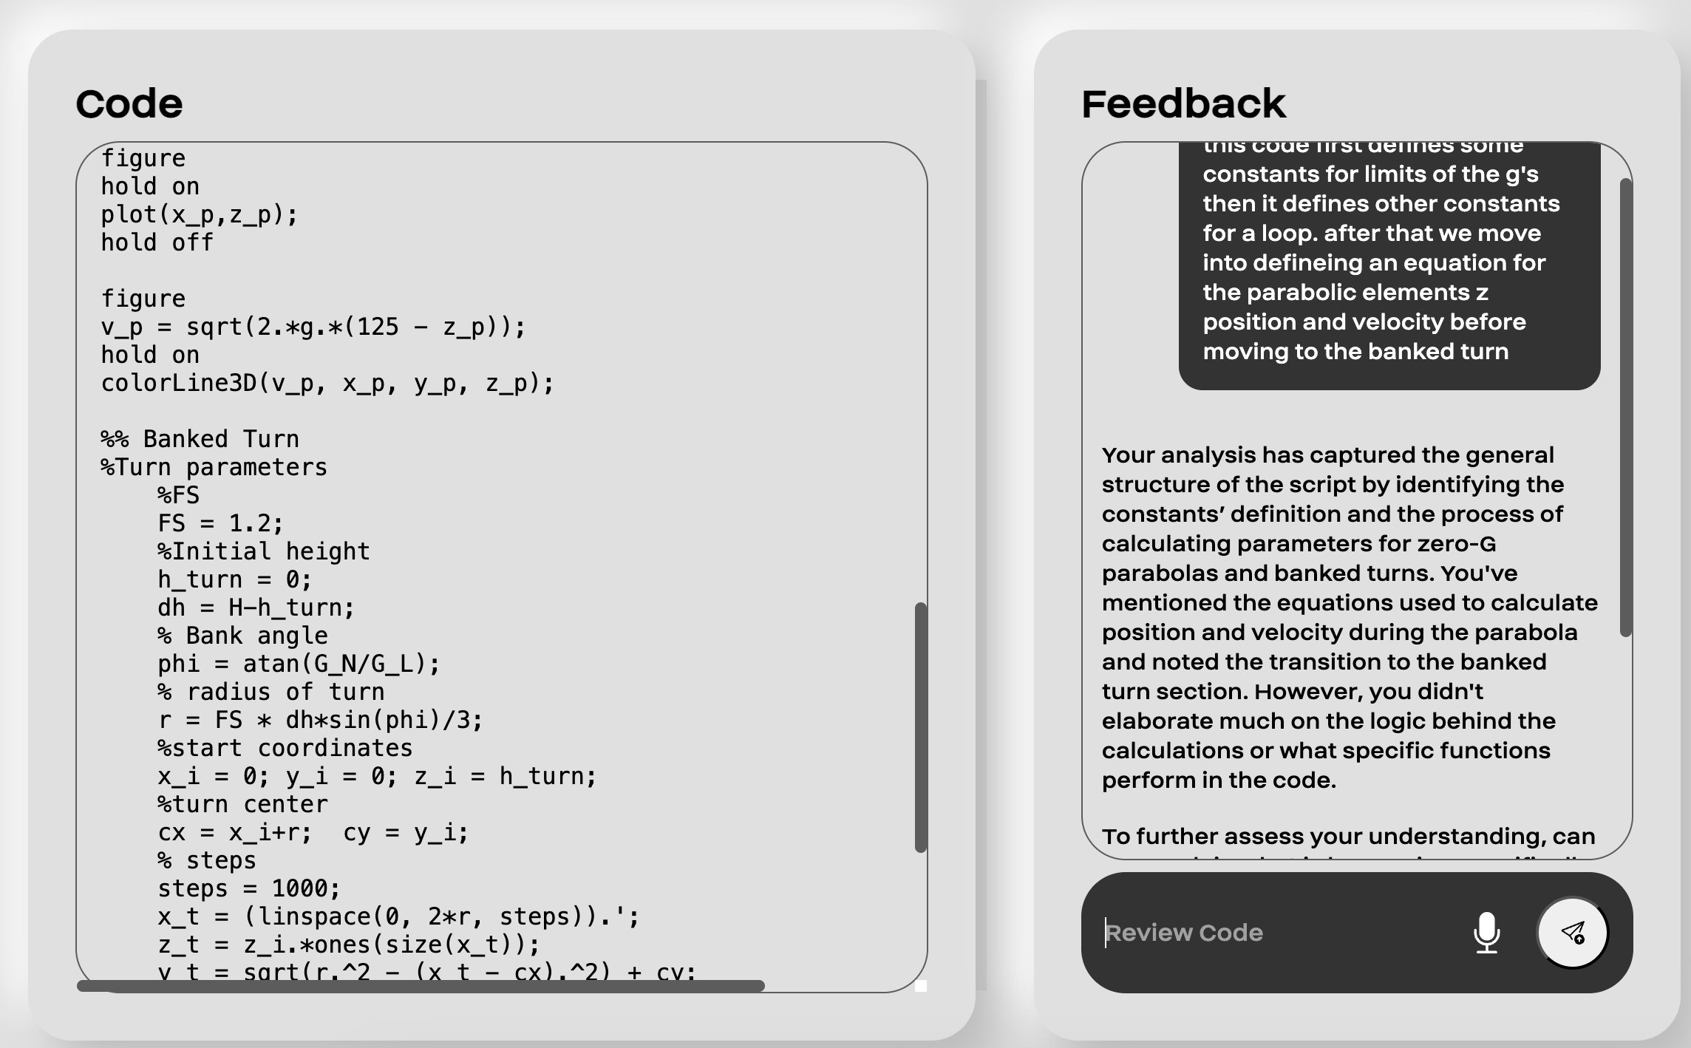
Student facing
AI Tutors
CustomGPTs (original)
Enterprise solutions
AI-augmented assignments
NotebookLM
Free
Notes:
Slide 1: Student-Facing Examples**
- Custom AI explanations available
- NotebookLM personalized topics
- Reinforce student course engagement
- AI-generated follow-up questions

Slide 7
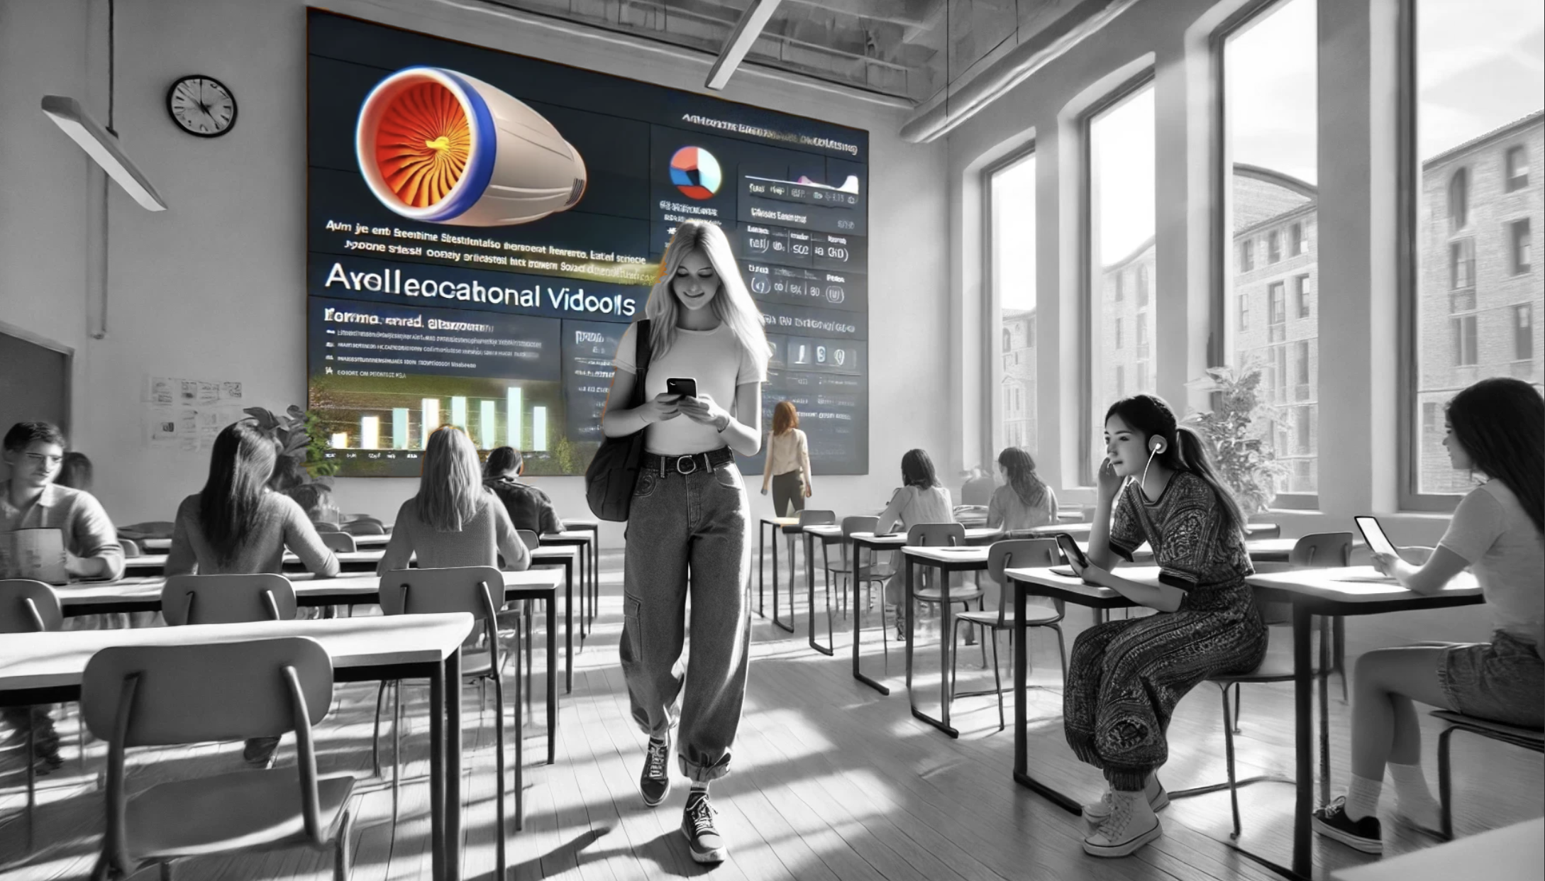
Back of house
Aptos 18 pt black Text Body

Slide 8
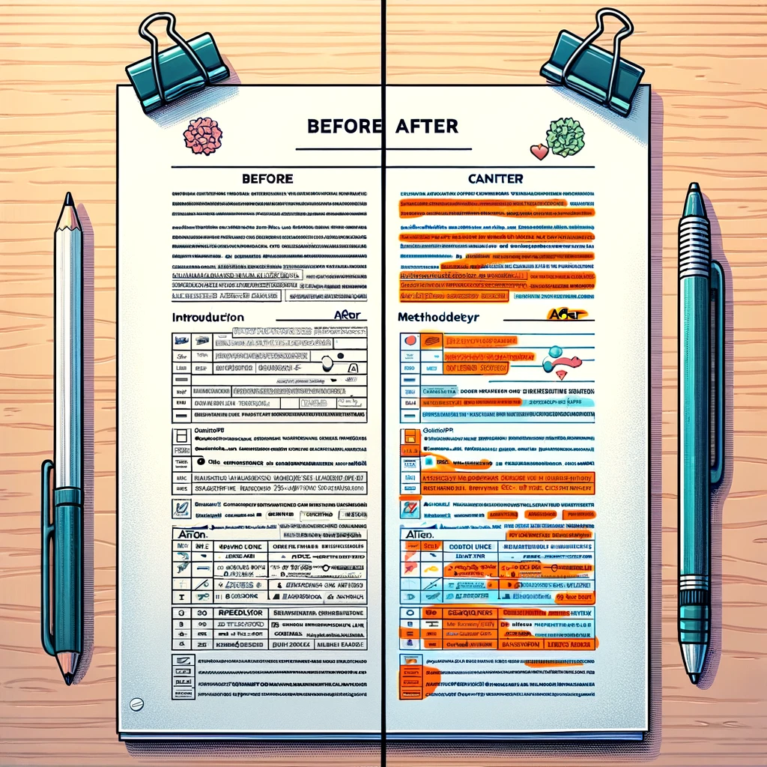
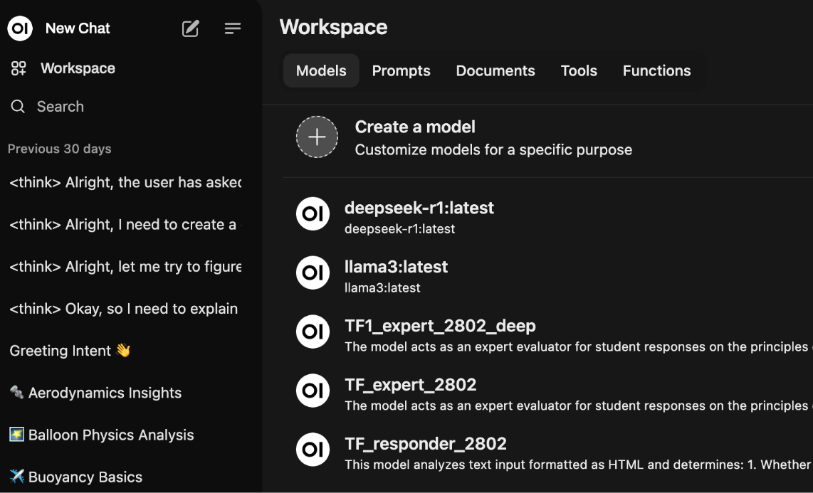

Back of house
AI-Assisted grading (concerns, benefits)
Consistency of numerical score
Efficiency - more time for human to human
FERPA compliance
NAIRR resources
In-house equipment
More time for human-human
“AI allows us to do the things we’ve always wanted to do but didn’t have the resources” - Prof. Mike Klymkowsky
Notes:
AI-assisted grading systems
- FERPA-compliant local models
- Faster feedback, clearer insights
- Human-centered instructor support

Slide 9

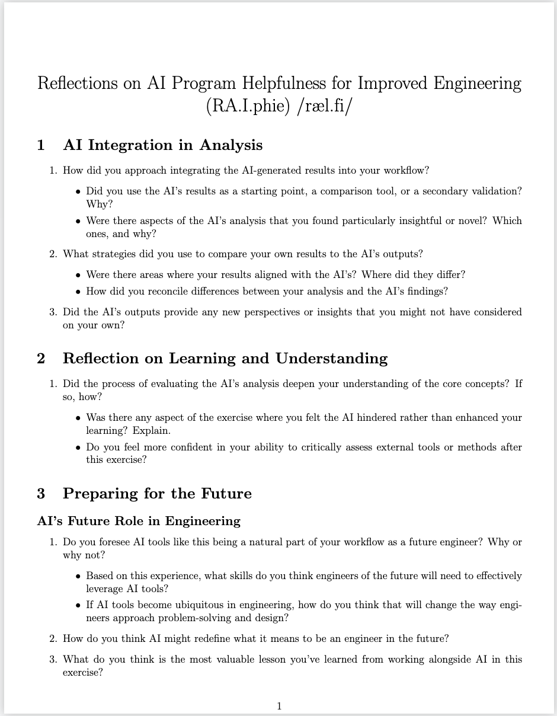
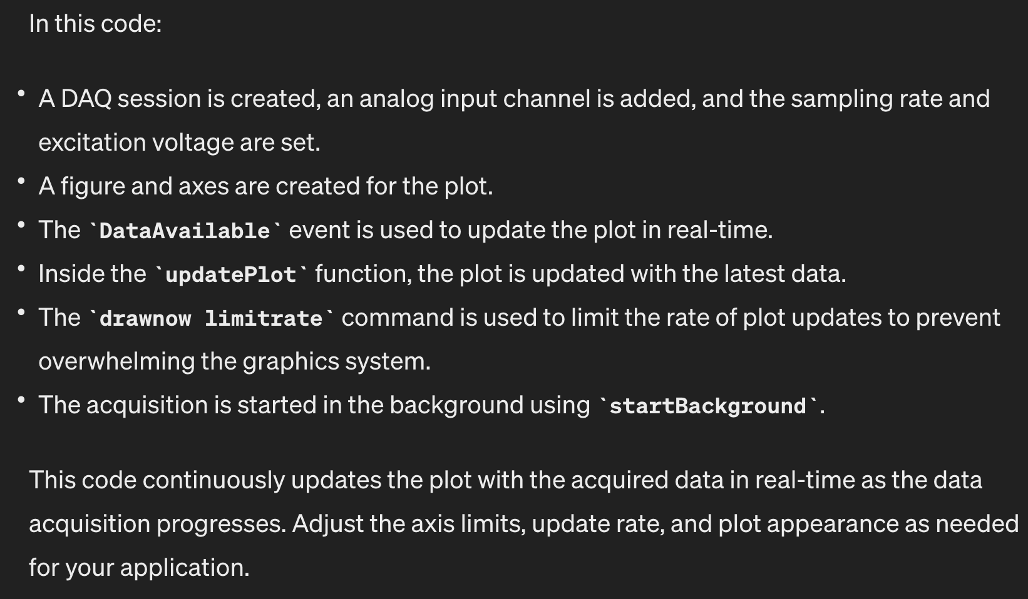

Preparing students for AI-augmented society
Idea credit:
Prof. Teresa Nugent ENGL 3016 “Writing in the age of AI”
“The AI-produced code had a solid framework but lacked the finishing touches required to complete the milestones fully”
“The most valuable lesson is that AI tools are powerful aids but require human oversight and critical evaluation. While they can streamline workflows and provide alternative perspectives, they may oversimplify complex processes or miss nuanced details”
"While AI excels at processing information and generating solutions, our oversight, creativity, and ethical reasoning remain indispensable"
B. Hodgkinson, “An Aeroelasticity Experiential Learning Activity with AI-Driven Comparative Analysis and Evaluation,” to be presented at ASEN 2025, Montreal, Canada, 2025.
Notes:
Add ASEE citation
Slide 1: rAIphie Mini-Study**
- Students skeptical of AI
- Surprising AI utility discovered
- AI structured coding effectively
- Detail-oriented human review crucial

Slide 10
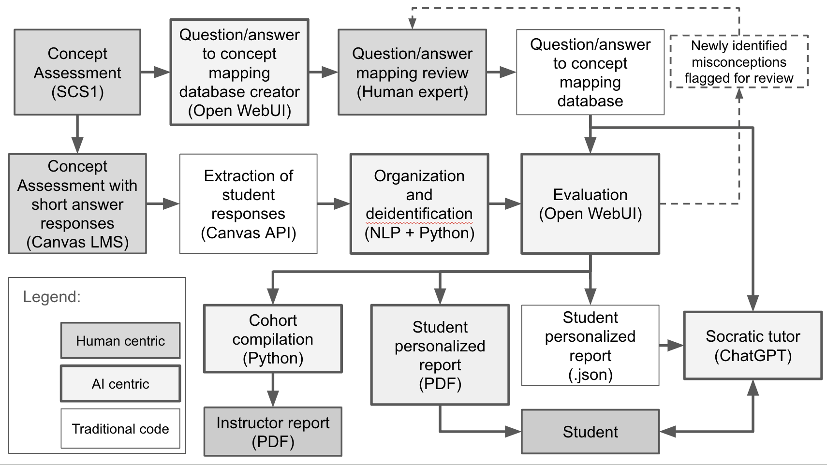
“AI allows us to do the things we’ve always wanted to do
but were too resource intensive”
Tool creation is feasible
Reliability is…more difficult
Learning opportunities
B. Hodgkinson, “WIP: Expanding AI-Driven Concept Inventory Analysis in Computer Science Education,” to be presented at ASEN 2025, Montreal, Canada, 2025.
Notes:
Paper submission citation
Slide 2: True/False AI Feedback**
- Intentional imperfect AI responses
- Students critically evaluate feedback
- Increased student material engagement
- Cross-disciplinary teaching insights

Slide 11
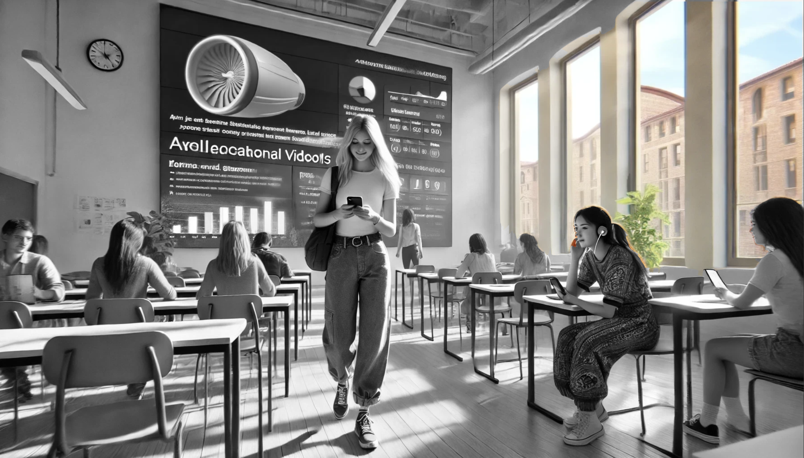

Slide 12
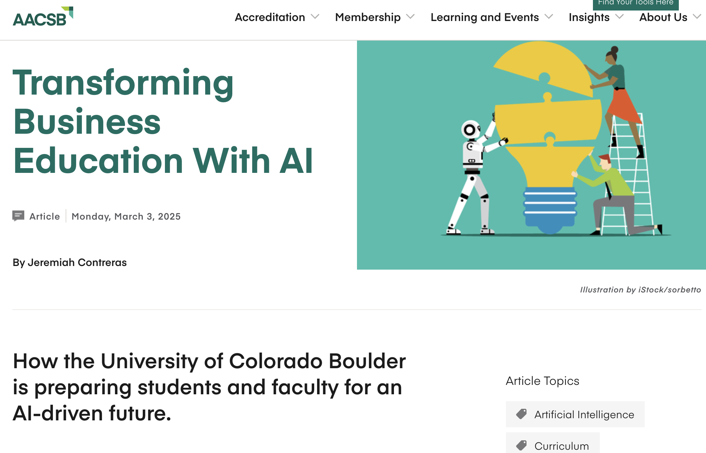
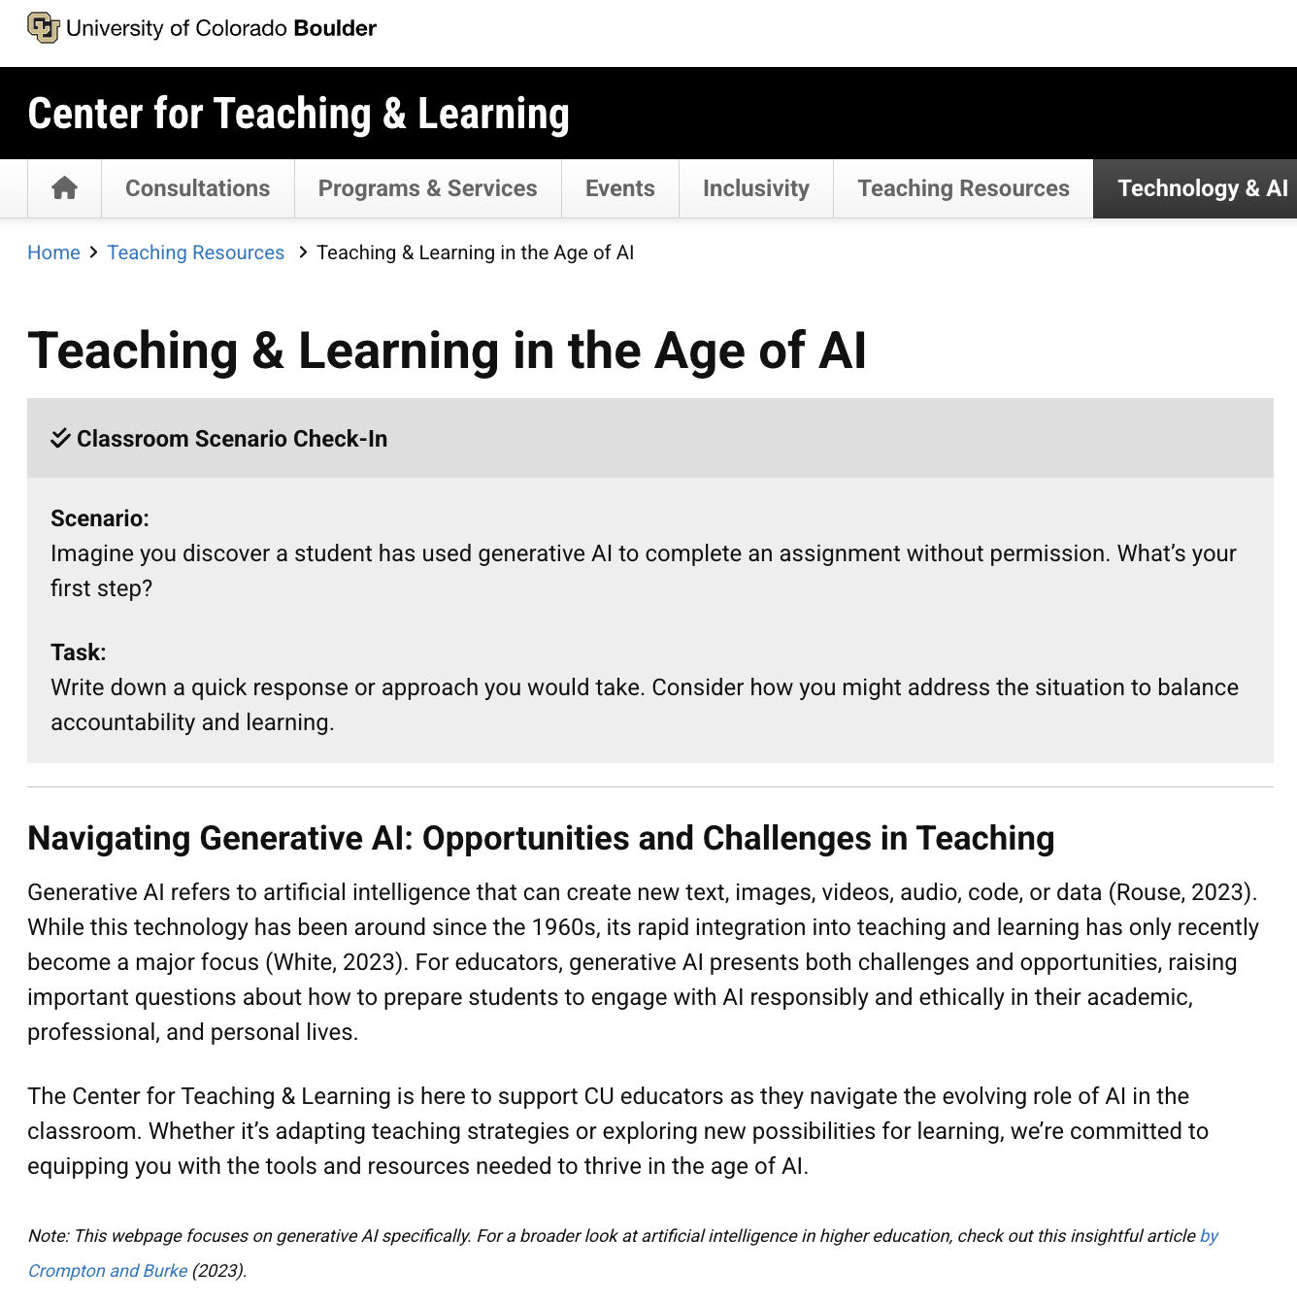
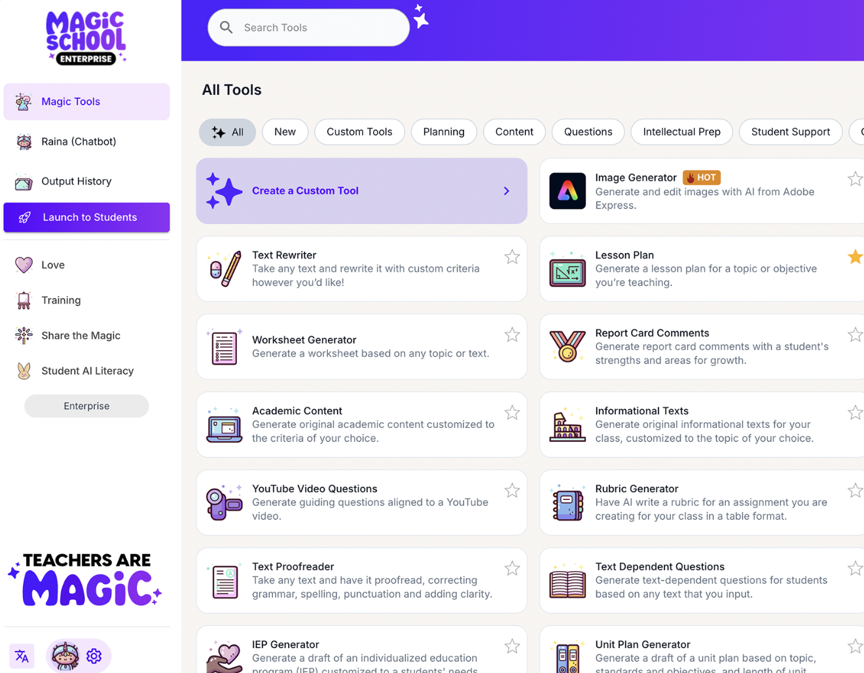
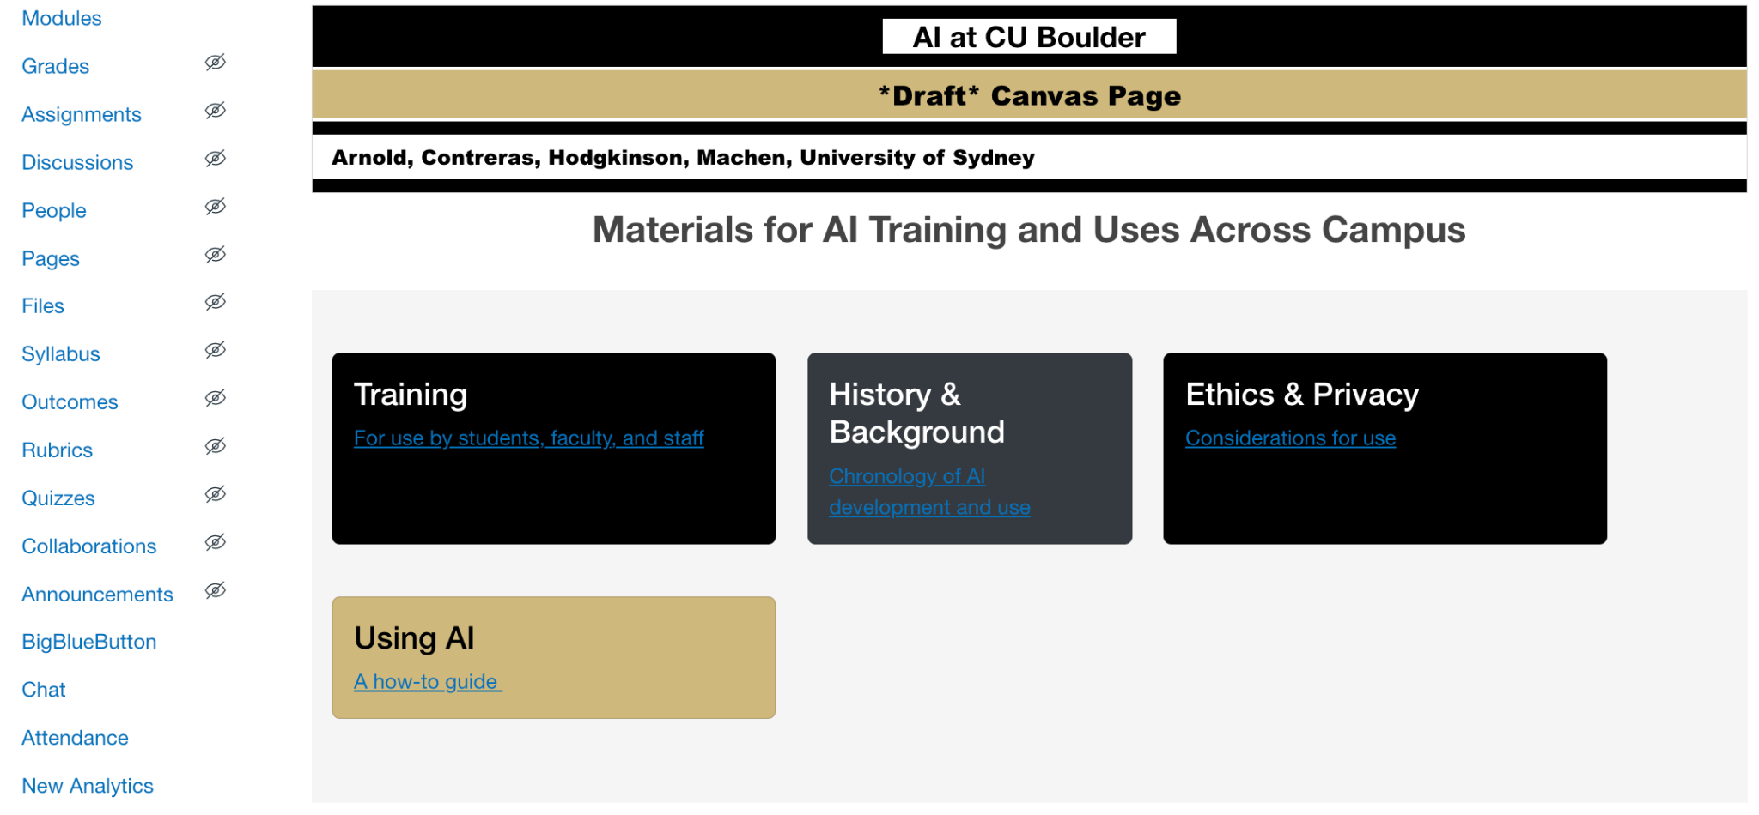
Outside the classroom
AI Literacy
Syllabus statements
Center for Teaching and Learning
Leeds Business School
Educator trainings
CU Boulder - grassroots training
BVSD - Magic School

Slide 13



Parents and Community
Personal Experience: ChatGPT with my daughter
(She wants me to tell this story)
Struggle in Advanced Math Class (4th/5th grade)
“Dad, my brain just doesn’t ‘do’ math”
Efforts to Improve by Parent Tutoring (me)
Tried ChatGPT as a Tutoring Tool
Tailored ChatGPT: Socratic and Supportive
Also: Female
Significant Improvement: Near Top of Class
N=1 findings:
More helpful at test prep than homework
Younger daughter wants to do the same
Guide not a solution manual

Slide 14
Looking ahead
Experiment with AI methods
Foster AI-enhanced learning
Explore research opportunities
“How does AI enhance learning”
Embrace AI educational opportunities
Interdisciplinary education
Learn from each other
Work alongside each other
Students are looking to us
“While I found it immensely helpful this semester, it was as equally unhelpful in more subtle, insidious ways. I’ve noticed it has been gradually decomposing my ability to overcome challenges independently. So much so that I often question if I am genuinely growing as a learner or inadvertently holding myself captive in a cruel loop of stagnation, relying too heavily on AI to bridge the gaps…This convenience, while alluring, has a coercive quality, making it difficult to resist the temptation of a quick solution rather than wrestling with the problem myself. I appreciate its capabilities, but I can’t help but remain cautious of its growing presence and the long-term effects it may have on my learning and autonomy.”
Notes:
Actively experiment AI methods
- Foster AI-enhanced student learning
- Join research-driven AI projects
- Embrace AI educational opportunities
“This convenience, while alluring, has a coercive quality, making it difficult to resist the temptation of a quick solution rather than wrestling with the problem myself. I appreciate its capabilities, but I can’t help but remain cautious of its growing presence and the long-term effects it may have on my learning and autonomy.”

